Slide 1
Enterprise Data Hub Enterprise Data Warehouse Rationalization
End-to-End Data Integration, Processing, and Offload
Andrew Swentzel: aswentzel@clouderagovt.com
Richard Im: rim@clouderagovt.com
Michael Lazar: mlazar@clouderagovt.com

Slide 2
Agenda
Enterprise Data Hub Overview
Demonstration
Summary
Additional Q&A

Slide 3
Questions
Multi-tenancy. Resource allocation, tracking – how do we ensure we don’t stomp on each other? How do we ensure access rights, down to the column or row level? What can / should be common components lending the environment to a “shared” environment rather than a bunch of applications running on the same box?
Parallel processing. Most are coming from an RDBMS environment. Explaining the name node vs. data node concepts. How does the system know where the data is located at? Pros of parallel processing & scaling. Compare the processing of an MPP to Hadoop.
Successful Use cases. Hit on Warehouse ETL offloading processes. Perhaps walk through a project flow that implemented it & what were the benefits seen?
Where do groups usually start? How do we decide which tool to use to access the data? Do we have to learn all of the tools?

Slide 4

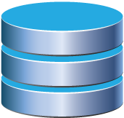

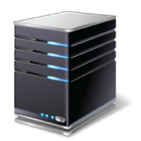
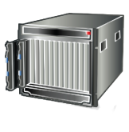


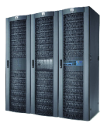
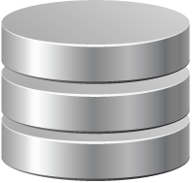


The Old Way: Bringing Data to Compute
4
Complex Architecture
Special-purpose systems
Moving data around
No complete views
3
Cost of Analytics
Existing systems strained
No agility
“BI backlog”
2
Time to Data
Up-front modeling
Transforms slow
Transforms lose data
EDWS
MARTS
SERVERS
DOCUMENTS
STORAGE
SEARCH
ARCHIVE
1
Missing Data
Leaving data behind
Risk and compliance
High cost of storage
ERP, CRM, RDBMS, MACHINES
FILES, IMAGES, VIDEOS, LOGS, CLICKSTREAMS
EXTERNAL DATA SOURCES
Notes:
Overview: 4 Challenges
The traditional approach is incredibly valuable, but carries with it some challenges that should be all too familiar...
Visibility
Time to Value
Cost
Complexity
Script
Across industries, our customers typically have the same four challenges with data management that prevent them from becoming truly information-driven:
[BUILD SLIDES WITH EACH NUMBER]
First, data silos and "dark data" lost in offline archives inhibit complete understanding of the business. Existing systems are too expensive or prohibitively complicated to scale, so you leave data out.
Second, existing analytical systems are too rigid. You need to model and transform all data before it's useful, but when you transform data you lose data.
Third, in many cases the data is trapped in silos that are running at full capacity to support important business workloads. Enterprises simply can't add more work in the form of BI or reporting to those strained systems. BI teams also struggle to keep up with changes in requirements and the pace of business. Without immediate access to all original data, it can take weeks or months to deploy new views of the business. There's a cycle here: IT can't build without direction from the business, but the business doesn't know what they want until IT produces it. By then it's too late, and there are always new questions to ask.
Fourth, moving data to special-purpose systems - those that can handle only specific kinds of data, or do only specific kinds of work - is hard enough, but becomes downright impossible at large scale. There has to be a better way than moving data around to each application.

Slide 5

The New Way: Bringing Compute to Data
4
Diverse Analytic Platform
Bring applications to data
Combine different workloads on common data (i.e. SQL + Search)
True analytic agility
3
4
3
Self-Service Exploratory BI
Simple search + BI tools
“Schema on read” agility
Reduce BI user backlog requests
2
2
Persistent Staging
One source of data for all analytics
Persist state of transformed data
Significantly faster & cheaper
SERVERS
MARTS
EDWS
DOCUMENTS
STORAGE
SEARCH
ARCHIVE
1
1
Active Compliance Archive
Full fidelity original data
Indefinite time, any source
Lowest cost storage
ERP, CRM, RDBMS, MACHINES
FILES, IMAGES, VIDEOS, LOGS, CLICKSTREAMS
ESTERNAL DATA SOURCES
Notes:
Overview: 4 Solutions
Active Archive
Transformations
Self-Service BI
Multi-Use Platform
Script
What’s needed is a new architecture to complement your existing investments and help put data at the center of your business: an enterprise data hub. An enterprise data hub lets you store any amount and type of data, securely and cost-effectively, for as long as you need; lets you access that data in any way you need; and provides the management and governance support that you require of all of your mission-critical infrastructure.
An enterprise data hub addresses each of our earlier problems:
[BUILD SLIDES WITH EACH NUMBER]
First, as an Active Archive it provides one place for all data of all types, cost-effectively retained in full fidelity for any period of time. As a staging area for new enterprise data, you could even call an EDH an automatic archive.
Second, it’s one place to transform data from its raw format into structured formats for consumption by existing systems, while retaining the original data for future use and reuse. Nothing is lost.
Third, business users get direct, agile access to specific data sets to explore and analyze in-place, reducing the BI backlog of business user requests and freeing capacity on existing systems.
The real benefit comes when you can increasingly bring new analytic workloads to the EDH, reducing the need to invest in and move large volumes of data between platforms just to ask new questions. Native engines - Batch, Streaming, Interactive SQL, Search, Machine Learning, and more - are complemented by 3rd-party products running directly IN the EDH, such as SAS VA and HPA, Revolution Analytics, Informatica, Syncsort, and Splunk's Hunk. Better analytical tools generate more value from more data, driving revenue and profit.

Slide 6
From Hadoop to an Enterprise Data Hub
Open Source Scalable Flexible Cost-Effective | ✔
Managed | ✖
Open Architecture | ✖
Secure and Governed | ✖
CLOUDERA’S ENTERPRISE DATA HUB
BATCH
PROCESSING
ANALYTIC
SQL
SEARCH
ENGINE
MACHINE
LEARNING
STREAM
PROCESSING
3RD PARTY
APPS
DATA
MANAGEMENT
MAPREDUCE
IMPALA
SOLR
SPARK
SPARK STREAMING
CLOUDERA NAVIGATOR
✔
WORKLOAD MANAGEMENT
YARN
STORAGE FOR ANY TYPE OF DATA
UNIFIED, ELASTIC, RESILIENT, SECURE
SYSTEM
MANAGEMENT
✔
, SECURE
SENTRY,
FILESYSTEM
ONLINE NOSQL
CLOUDERA MANAGER
✔
HDFS
HBASE
Notes:
Overview
NOTE: This slide is optional, but a useful way to introduce Hadoop. Typical talk track might be: “So we’ve introduced the concept of an enterprise data hub built on Hadoop. But what is Hadoop?”
* We provide an enterprise data hub, built on the foundation of Apache Hadoop. Our focus is on solving
customer problems, and it's instructive to look at the evolution of the platform through that lens.
* Tell the Hadoop story here – our history of solving customer problems.
* Hadoop when born was any kind of data, cost effective.
* Open source, hard to manage.
* So we fixed that, added Manager.
* It did useful work, but only had one way to access data.
* So we added Impala, search, Spark.
* Customers moved it into the middle. It began to function as a hub.
* Then they needed security, governance.
* So we added Sentry, Navigator.
* Now enables you to put data at the center of your enterprise, become information-driven.
Script
The foundation of our enterprise data hub is Apache Hadoop, an open source platform for scalable, fault-tolerant data storage and processing that runs on a cluster of industry-standard servers. But Hadoop, in the beginning, wasn't capable of solving these problems. Originally, Hadoop was just a scalable distributed system for storing and processing large amounts of data. You could bring workloads to an effectively limitless amount and variety of data, provided the only kind of work you wanted to do was batch processing by writing Java code, and provided you liked hiring highly-skilled computer scientists to operate it.
[SLIDE BUILD #1]
Cloudera solved the latter problem with Cloudera Manager, the leading system management application for Apache Hadoop. Customers love Cloudera manager because it makes the complex simple. Hadoop is more than a dozen services running across many machines, with limitless configuration permutations. With Cloudera Manager, customers can centrally manage and monitor their clusters from a single tool. It provides automated installation and configuration of your cluster. Cloudera Manager is really our many years of Hadoop experience realized in software, and helps you get up and running quickly.
[SLIDE BUILD #2]
Our customers liked the scalability, flexibility, and economic properties of the platform, but, for example, didn't like that they had to move data out to other MPP analytic databases just to run fast SQL queries, so we built Impala, the world's first open source MPP analytic SQL query engine expressly designed for Hadoop. With Impala, you now have a viable open source alternative to proprietary MPP analytic databases, one that also delivers the core scalability, flexibility, and economic benefits of Hadoop.
Now, over the past year we've continued to add to the platform, with Search, and Spark for interactive iterative analytics and stream processing. You also get HBase, the online key-value store, to enable real-time applications on the platform. With this range of diverse ways to access your data in Hadoop, far beyond just Java and MapReduce, you can now bring your existing tools and skill sets to the platform. What's even more exciting is that we've recently made it possible for our partners and other 3rd parties to deploy, manage, and monitor their apps in the platform, again leveraging exciting your investments while letting you access an even greater breadth and depth of data, all in one place.
[SLIDE BUILD #3]
Of course, none of this would matter if the platform weren't reliable, secure, and manageable.
Hadoop today is highly available and Cloudera provides extensions for automated backup and disaster recovery.
Hadoop has had perimeter security for some time but there was a significant gap in the area of fine-grained role-based access controls, the kind you'd expect from a DBMS. That's why, together with the community, we built and contributed the Apache Sentry project which delivers this security for Hive and Impala today, and why we developed Cloudera Navigator to support metadata management, including things like rights auditing, data lineage, and data discovery native to Hadoop.
And all this in addition to the industry-leading system management and customer support you expect from Cloudera.
So you can see a lot has happened in just a few short years. Hadoop isn’t just Hadoop anymore. Ultimately, it has evolved into the foundation of an enterprise data hub.
So how does the architecture of the enterprise data hub solve these problems?
1. Dramatically low cost of storage so you can store all the data. This means you can load the data with minimal resistance. You don’t have to select what fields and values you want before loading data in, you don’t need to understand the structure or schema of the data. You don’t need to understand the questions you’re going to ask ahead of time.
2. Using a file system or key/value store means you can load raw data, which may be non-relational data. Suppose you want to load a bunch of binary images, process them to generate metadata about the images, and then store that metadata in relational form - no problem. Combine historical weather data with transactional data. One person can load encrypted data into the system even if they don’t have the ability to read it.
3. Co-locating the compute with the data means you can process lots of data at scale.
You can do complex transformations in-situ without burdening the network.
4. Separating the compute and storage systems means you can use whatever processing or analytic engine is right for the task. Whether it is batch processing with MapReduce, Pig or Hive
Machine learning or stream processing with Spark,
interactive SQL with Impala, or free text search with Cloudera Search
They wall work in-situ on the same data sources.

Slide 7




















Cloudera’s Enterprise Data Hub
Integration with Over 200 ISVs
Self-Service BI
Data Exploration
Visualization
Flexible Deployment Options
On-Premise or Cloud
Appliances
Engineered Systems
ACTIVE ARCHIVE
SELF-SERVICE BI
Powerful Security Solution
Risk Analysis
Fraud Prevention
Compliance
OPEN
Infinite Analytic Storage
Multi-Structured Data
In-place Analytics
Active Archive
MANAGED
APACHE
HADOOP™
GOVERNED
SECURE
CENTRAL TRANSFORMATION
MULTI-WORKLOADS
Advanced Analytics Engine
360° Customer View
Recommendation Engines
Processing & Analytics
Improve IT Operations
ETL Acceleration
EDW Rationalization
Mainframe Offload
Notes:
Cloudera has a wide variery of

Slide 8
Demonstration Phases

Slide 9
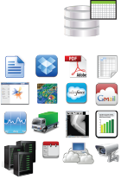
Modern Architecture
Enterprise Data Warehouse
Serve
BI System
Active Data
EDW
Unstructured
Load/ Archive
Modeling
2
Cloudera
ELT
Structured
Ingest
Reporting
Serve
1
3
Operational Data Store
Applications
Data Sources
Operational Data Store
SECURITY
GOVERNANCE AND PROVENANCE
Load Data
Files
Data Base
Ingestion
2) ELT
3rd Party ETL/ELT tools
Parallel Processing
3) Explore and Export
3rd Party BI tools
External DBMS
External Files
Notes:
Cover ETL vs ELT
We have been working closely with leading organizations to create a platform that allows them to complement their current architecture in order to avoid these common challenges. This in turn prepares for future growth of data within their organizations.
Collect & Access More Data-
Cloudera allows you to collect and ingest any data type or volume of data, in full fidelity, in order to allow for complete data access to your current systems and end users. This has allowed organizations to collect and access more diverse data, opening up the possibilities of what data can do for the business, without compromising system performance or existing resource constraints.
Efficiently Process & Store Data Volumes-
By offloading heavy processing workloads to Cloudera, organizations are able to use parallel processing in order to significantly reduce processing time on large volumes of data. With the scalable nature of Cloudera, you also ensure that no matter how much data is stored the platform continues to perform at peak performance.
Automated Secure Archive-
Leveraging Cloudera as an ODS and using it as a centralized staging environment for new data allows you to automatically create a secure archive. Because of the platform’s scalable nature, there is never a reason to archive your data. Historic data can remain on the platform for analysts allowing them complete access without derogating system performance. While smaller volumes of already defined active data can run directly into the right systems, with outdated data being offloaded to Cloudera.
Leading data organizations have already seen these benefits.

Slide 10
Phases
Load the data
Transform the data – ETL/ELT
Query the data - Interactive SQL
Explore the data - Faceted Search
Security - Authentication and Authorization
Governance - Audit, Lineage, and Discover
Export to RDBMS

Slide 11
Anatomy of Demo
Personas
cloudera user, susie_auditor, frank_inspector
External Database with tables populated
Excel file
Publicly available metadata
3rd Party Tool for ETL
HUE
Shell

Slide 12
1. Load the data

Slide 13


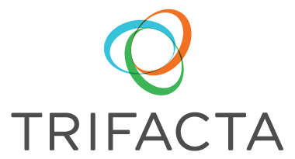
Integrate Data Sources
Automated Ingest Tools
HUE – File Ingest
SQOOP – DBMS Ingest in parallel
Flume – Streaming data
Oozie – Automated workflows
Partner products 23+
Notes:
Schema-on-Read discussion at this pont
Mention multiple file ingest paths – Hue has
-----
Meeting Notes (9/18/14 09:54) -----
using users data files - dont just limit to excel
Performance for load!! Scale!!

Slide 14
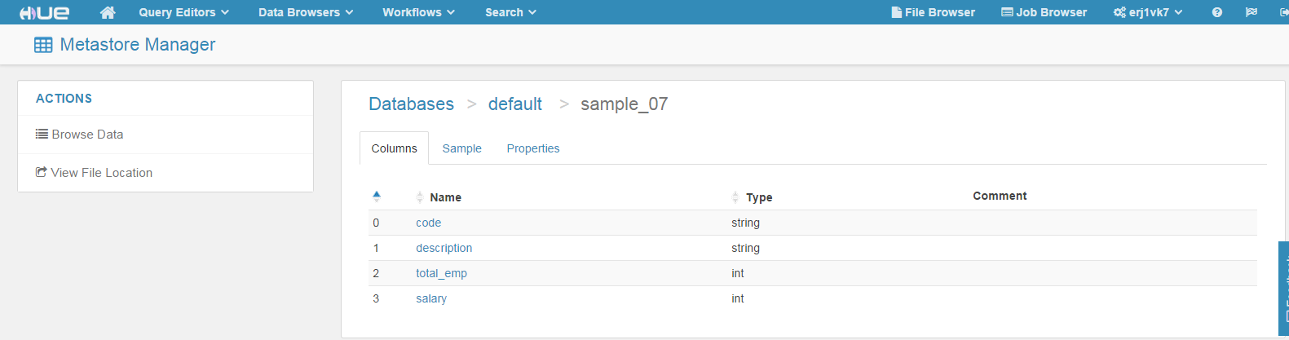
Relational Metadata

Slide 15
Demo 1. Load Data

Slide 16
Data Loading is Easy
Easy/automated metadata creation
Files HUE
Also via command line, file mounts, API
Database loads automated via SQOOP
Streaming data automated via Flume
Large number of 3rd party data integration tools
Notes:
All tables loaded and available
Loaded From
RDBMS
Desktop File
Direct
Performance via sqoop
----- Meeting Notes (9/18/14 10:10) -----
loaded from rdbms, desktop file, direct

Slide 17
2. Data Transformation ETL
Notes:
Lets talk about the next topic manipulating the data once it is in an EDH

Slide 18
Extract, Load, Transform (ELT)
Transform in EDH vs EDW
No need of schema data ingestion
Easy to apply schema
Easy to transform data
Clean up data
Merge data
Optimize formats
3rd Party Partners
Notes:
Pentaho Kettle - Spoon
Simple ELT Job
Spawns parallel transformation on Cloudera Platform
Design and deploy from Tool
Will generate data combined from multiple datasets into combined view
Available to export

Slide 19
Demo 2. Data Transformation
Notes:
The T in ELT/ETL

Slide 20
Flexible, Scalable Data Transformation
Easy to transform data
Code, SQL, 3rd Party Tools
Easy to merge data sets
Saves expensive enterprise data warehouse resource
Meet SLA
Use an EDH to feed data warehouses
Notes:
While data transformation is not much different in an EDH from a process point of view
It is different in that it is NOT required, less expensive, and affordably scalable to meet SLAs
Data is now integrated
combined_etl_table

Slide 21
Summary so far
Easy to move data into Hadoop
Format does not matter to Hadoop
HDFS can treat data as files, tables, records or documents
Can perform data cleanup/transform

Slide 22
3. Query the data – Interactive SQL

Slide 23

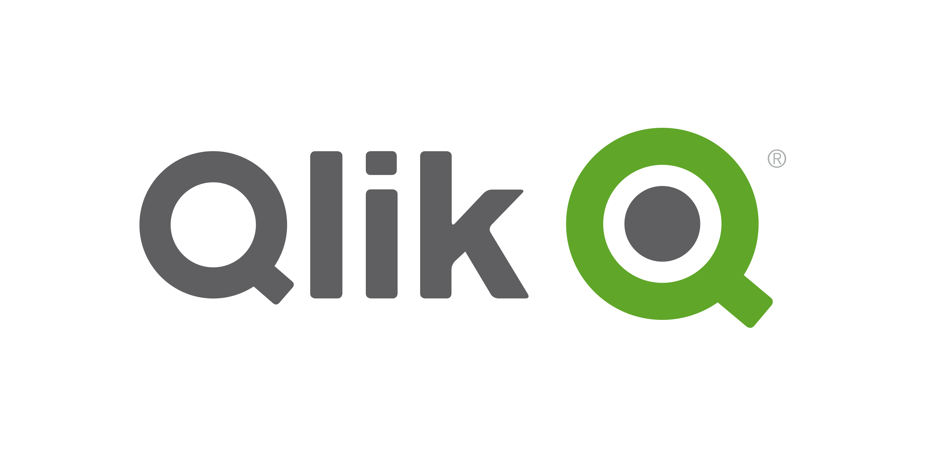





Cloudera Impala – Interactive SQL
MPP SQL-on-Hadoop Engine for BI Analysts
Familiar
Fast
Multi-user
Integrated & Secured
BATCH
PROCESSING
ANALYTIC
SQL
MULTIPLE FRAMEWORKS
IMPALA
WORKLOAD MANAGEMENT
STORAGE
FILESYSTEM
ONLINE NOSQL
Notes:
Hadoop is open for business analysts.
Impala = SQL-on-Hadoop for BI users
Unlocks self-service, exploratory BI on any Hadoop data
Impala is a modern MPP SQL query engine that runs *in* Hadoop (no data movement)
It is the industry standard for SQL-on-Hadoop (common benchmark though it still wins on performance and is >10x faster than latest Hive)
100% Open Source
Familiar
Leverage existing SQL and BI skills
ANSI SQL-compliant
Certified on popular BI/visualization tools
Flexible and highly concurrent
Highly optimized query engine
ad-hoc reporting capabilities for multiple users
Quickly explore any Hadoop data
Schema on read or write
Fast
Interactive performance at Hadoop scale
Support the same number of users with fewer machines to help achieve lower TCO
5-8x faster than Apache Hive .13 on Tez
Integrated and shipped with Cloudera’s enterprise data hub to make it easy to manage (integrated with YARN and Manager – easy installation/monitoring/management/upgrades) and secure/govern (Navigator + built-in security with granular RBAC and auditable permissions)
Lowest TCO, meets compliance requirements
Built on common services: security, metadata, governance, management
Use Cases
Data warehouse offload
Interactive BI/analytics on more data
Full-fidelity, active compliance archiving

Slide 24
Demo 3. Query the Data

Slide 25
Easy to Query Data
Easy to use SQL to query data
Supports 25+ leading BI tools
Industry standard
JDBC, ODBC, SQL

Slide 26
4. Explore the data – Faceted Search

Slide 27
Cloudera Search
Open Source, Full-Text Search for Everyone
Accessible
Standard
Flexible
Integrated & Secured
Everyone knows search
|
Search
BATCH
PROCESSING
SEARCH ENGINE
MULTIPLE FRAMEWORKS
SOLR
WORKLOAD MANAGEMENT
STORAGE
FILESYSTEM
ONLINE NOSQL
Notes:
“Google” for Hadoop to Explore, Navigate, Correlate (anyone who can google can use it)
CDH is the only commercial Hadoop distribution with a native, production-ready search solution
Accessible
Interactive full-text and faceted navigation
Anyone who can google can query data – multi-audience friendly with familiar web-style search and browse
Solve new challenges with Hadoop
Real-time exploration of all data
Easily access unstructured data
100% Open Source/Enterprise Standard
Built on Apache Solr, the standard for search
Industry standard search engine
Multi-vendor support – zero lock-in
Mature code base, vibrant community
Flexible
Rich API and ecosystem
No need for separate search and Hadoop
Consolidate infrastructure for lower TCO
Batch, real-time, and on-demand (re)indexing
Multi-datatype, multi-format support (great for unstructured and semi-structured)
Natively integrates with other Hadoop engines
Integrated and shipped with Cloudera’s enterprise data hub to make it easy to manage (integrated with YARN and Manager – easy installation/monitoring/management/upgrades) and secure/govern (Navigator + built-in security)
Cloudera + Solr Advantage
Data consolidation and correlation of multiple data sets in real-time
Query options include “fuzzy” search, clustering, and document grouping
Scalable computing and storage on a single, shared infrastructure – minimize data movement
Streamlined operations and cost-efficient data management

Slide 28
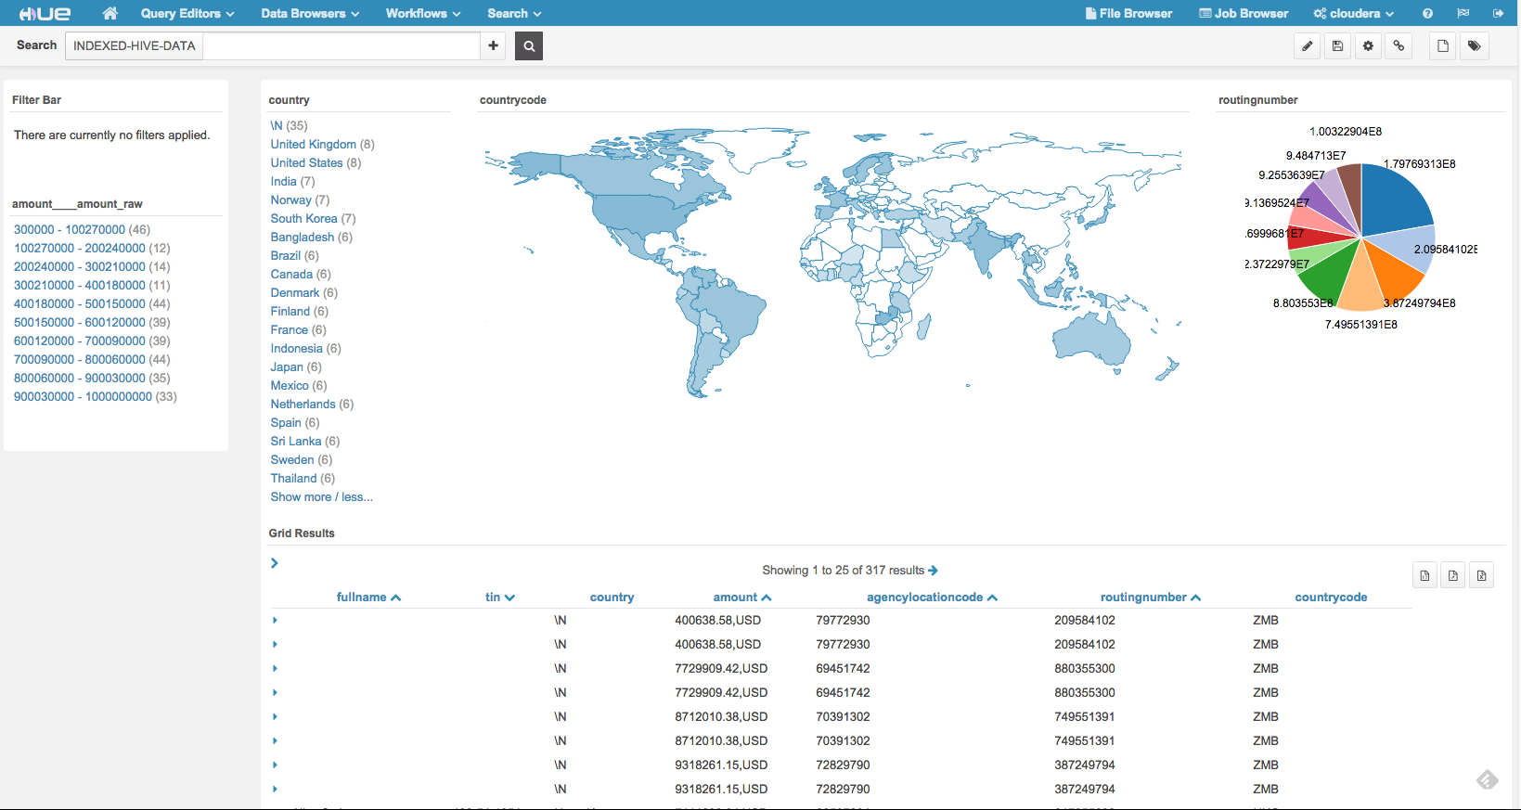
Visual Exploration – Faceted Text Search

Slide 29
Demo 4. Faceted Text Search

Slide 30
Cloudera Search
Quick and easy to get to data
See how data clusters
Integrated in a number of BI tools
Fully compatible with Open Source Solr (so lots of tools for Solr work)

Slide 31
Summary so far
Multiple familiar data query paths
File, Interactive SQL, Faceted Text Search
Analytics (packaged and custom)
Easy Data Ingest and Transformation
Notes:
We just saw Query and Search..

Slide 32
5. Security - Authentication and Authorization

Slide 33
Comprehensive Security and Governance
Perimeter
Guarding access to the cluster itself
Technical Concepts:
Authentication
Network isolation
Data
Protecting data in the cluster from unauthorized visibility
Technical Concepts:
Encryption, Tokenization,
Data masking
Access
Defining what users and applications can do with data
Technical Concepts:
Permissions
Authorization
Visibility
Reporting on where data came from and how it’s being used
Technical Concepts:
Auditing
Lineage
Kerberos | AD/LDAP
Cloudera Navigator
Certified Partners
Sentry
Cloudera Navigator

Slide 34

Apache Sentry: Key Capabilities
Fine-Grained Authorization
Specify security for SERVERS, DATABASES, TABLES, VIEWS, and Documents
Role-Based Authorization
SELECT, INSERT, TRANSFORM privileges
ALL privilege to modify or create tables, metadata, etc
Multitenant Administration
Separate policies for each database/schema
Can be maintained by separate admins
Notes:
Quick discussion (60 seconds or less) on role based security
Can have multiple roles (union of privileges)
White list only to make this possible
No privilege – NO access
----- Meeting Notes (9/18/14 10:36) -----
hide?

Slide 35
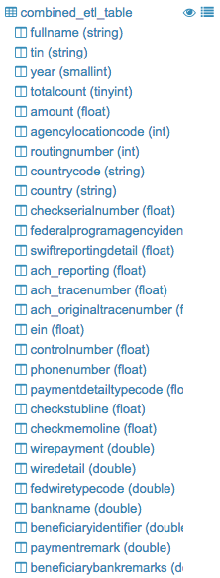
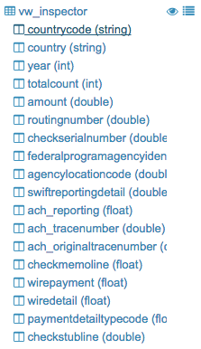
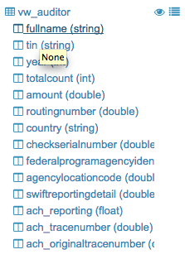
Authorized Users Only – Same Dataset
…
Notes:
Combined table had separate views so users have separate data privileges
Users can only see/access the views they are authorized for based on their role(s)
----- Meeting Notes (9/18/14 10:36) -----
hide?

Slide 36
Demo 5. Security - Authentication and Authorization

Slide 37
Summary
Protects the data from unauthorized access
NIST standard approach
Data policies and roles control who sees data
Different users of the system may see different things

Slide 38
6. Audit, Discovery, and Lineage

Slide 39
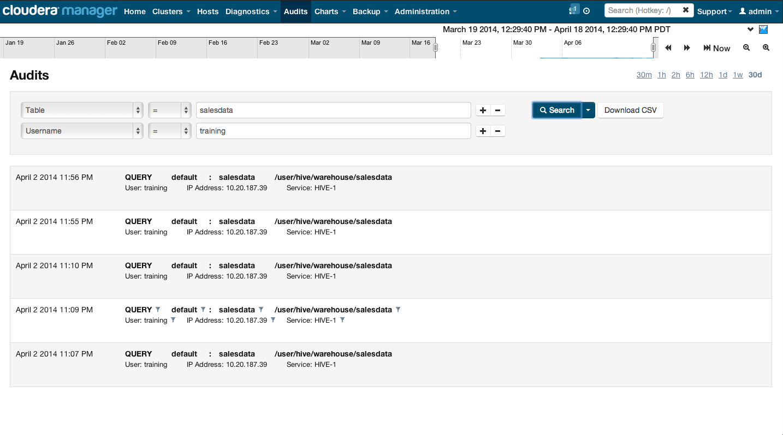

Audit

Slide 40
Demo 6. Audit

Slide 41
Audit
Inescapable
All file access
All query access
Alerts
Unified
Exportable

Slide 42
6. Lineage & Discovery

Slide 43
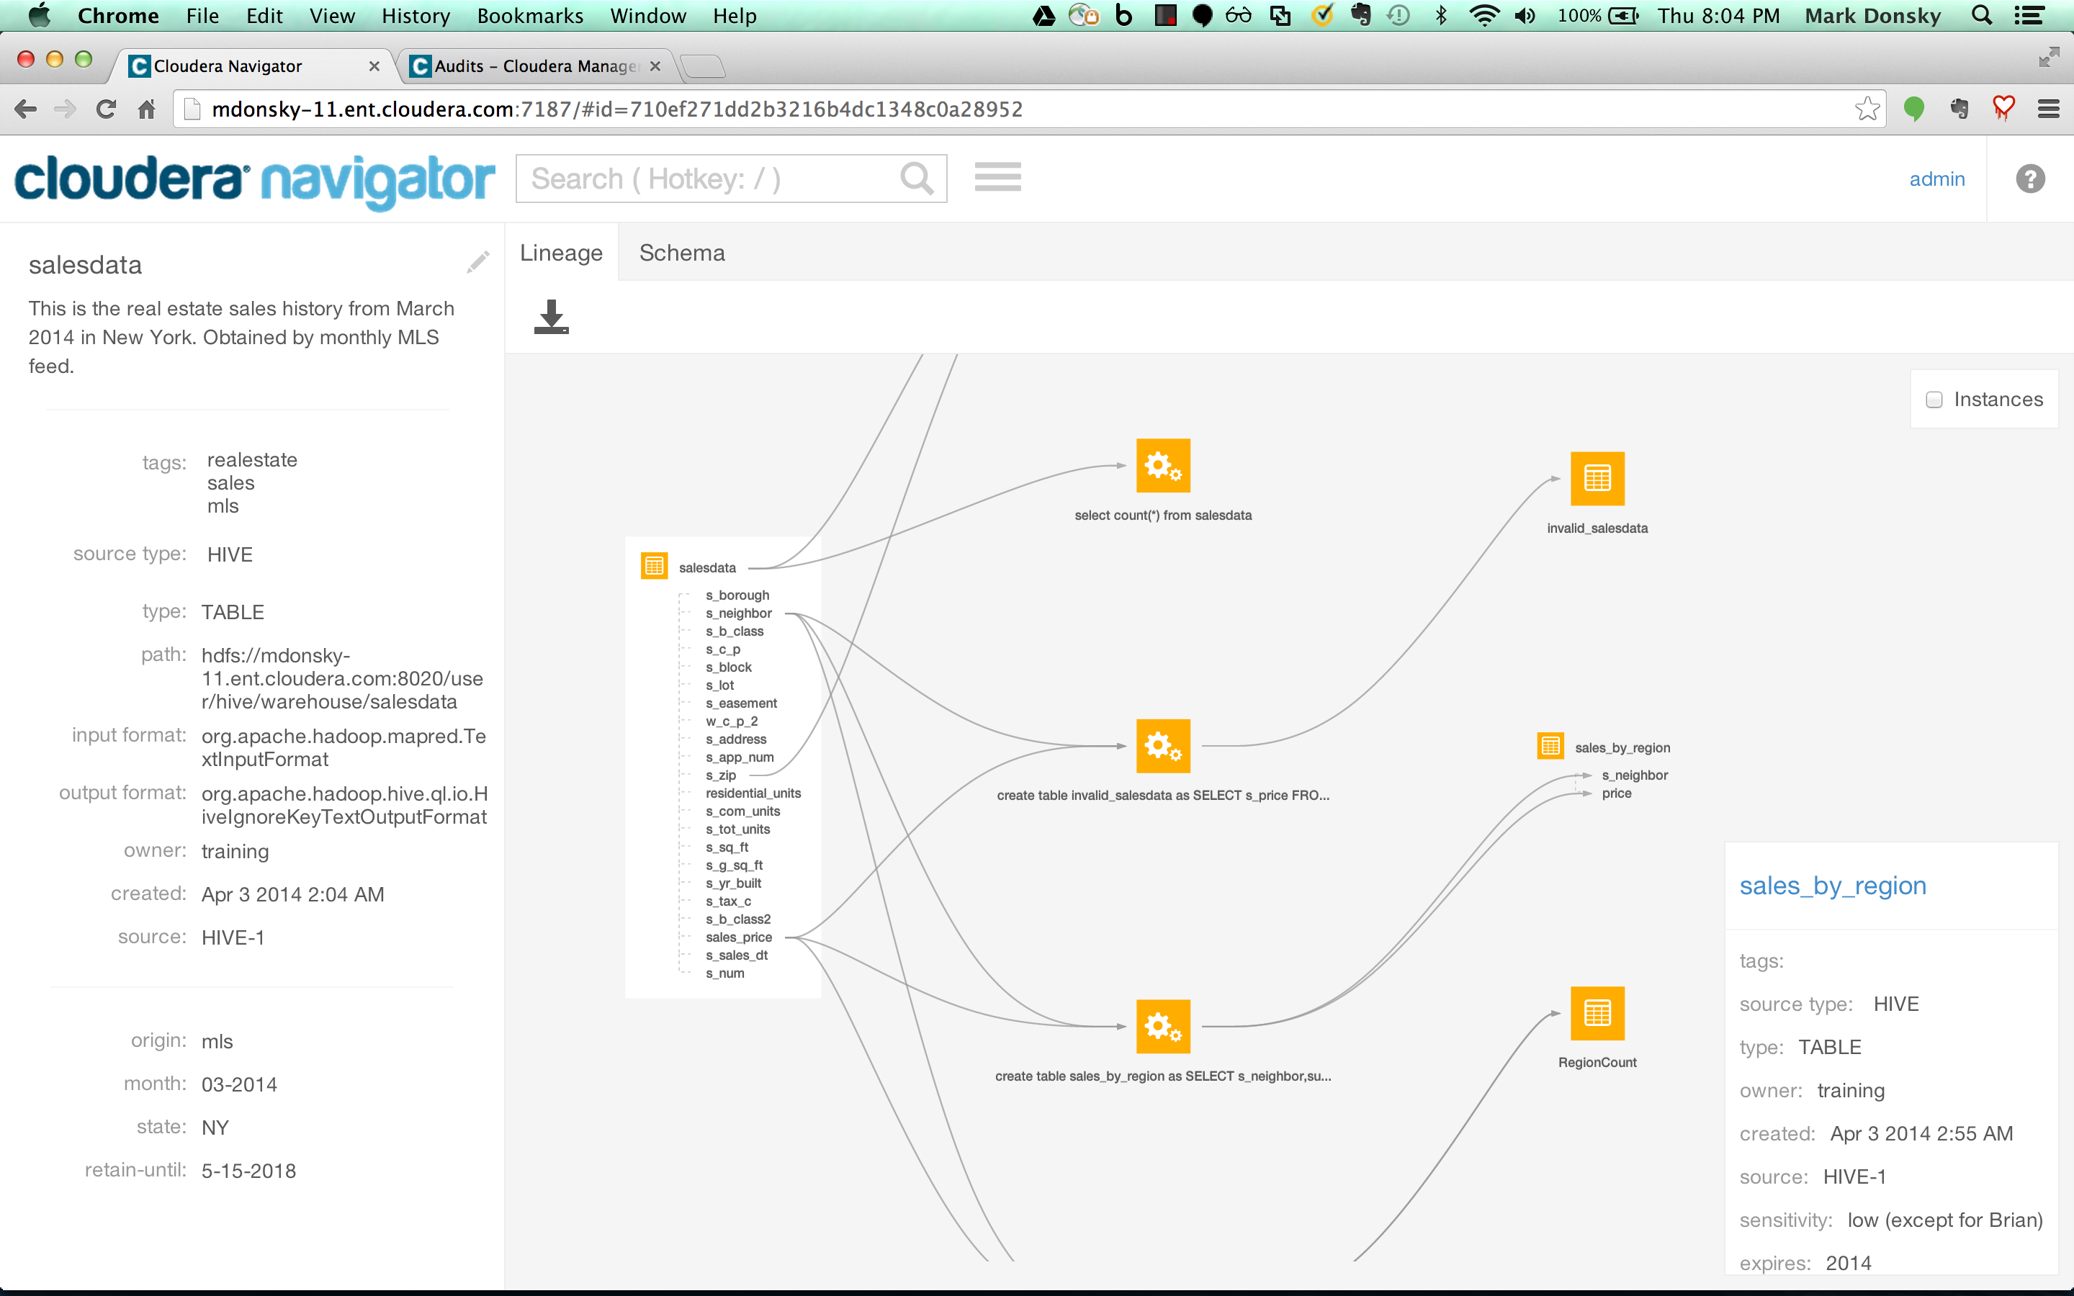
Navigator Lineage
Notes:
Why you need Navigator:
Lots of Data Landing in Cloudera Enterprise
Huge quantities
Many different sources – structured and unstructured
Varying levels of sensitivity
Many Users Working with the Data
Administrators and compliance officers
Analysts and data scientists
Business users
Need to Effectively Control and Consume Data
Get visibility and control over the environment
Discover and explore data
----- Meeting Notes (9/18/14 10:36) -----
screenshot of demo

Slide 44
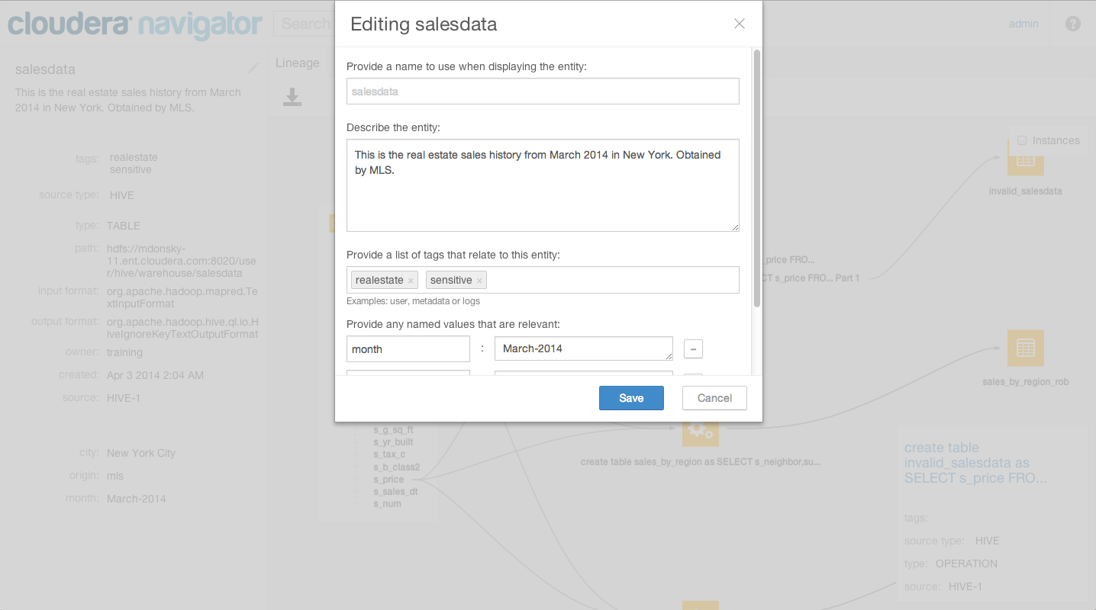
Notes:
Discuss editing Business Metadata
Description of data source
Tags
Custom properties

Slide 45
Demo 6. Lineage & Discovery

Slide 46
Summary
Capture business and technical metadata
Capture data lineage
Explore/Discover

Slide 47
7. Export to DBMS and Conclusion

Slide 48
Export to Warehouse
Any processed data can be exported
Same tool to import can export
Special connectors for Teradata, Oracle, Netezza

Slide 49
Demo 7. Export to DBMS/EDW

Slide 50
Summary
Leading BI and statistical tools certified
Concurrent, interactive, analytic SQL
Active archive, offload from EDW
Supports technical and business metadata
Supports discovery using metadata

Slide 51
Modern Architecture
Enterprise Data Warehouse
Serve
BI System
Active Data
EDW
Unstructured
Load/ Archive
Modeling
2
Cloudera
ELT
Structured
Ingest
Reporting
Serve
1
3
Operational Data Store
Applications
Data Sources
Operational Data Store
SECURITY
GOVERNANCE AND PROVENANCE
Load Data
Files
Data Base
Ingestion
2) ELT
3rd Party ELT tools
Parallel Processing
3) Explore and Export
3rd Party BI tools
External DBMS
External Files
Notes:
Security
A&A
RBAC
Audit
Encrypt
Governance – business metadata, technical metadata , lineage, discovery of data by metadata (technical and business)

Slide 52
Summary – EDH data warehouse rationalization
Reduce cost
Meet SLAs
Easy data ingest and egress
Open Source / Open Environment

Slide 53
Summary
Load the data
Using existing files, desktop tools, integrate to databases and more
Transform the data – ETL
3rd party ecosystem of tools
Query the data - Interactive SQL
Interactive SQL for descriptive and advanced analytics
Explore the data - Faceted Search
Visual tools and Search Application to explore, open to wide audience
Security - Authentication and Authorization
Security throughout the entire platform
Audit, Discovery, and Lineage
Data Governance and Provenance
Export to Dataware

Slide 55
Schema Design
Schema on Write
Design time
Map data sources
Extraneous data
Expensive to change
Indecision is the basis of flexibility
Notes:
Traditional build to schema
Schema on write – comments field example - new data source example
Still need Schema
-- Indecision is the basis of flexibility
-- Want to be able to change your mind at little or no engineering cost
New source of data integration (time-to-action/time-to-value)
Still may choose to do some optimization talk about that in a bit

Slide 56
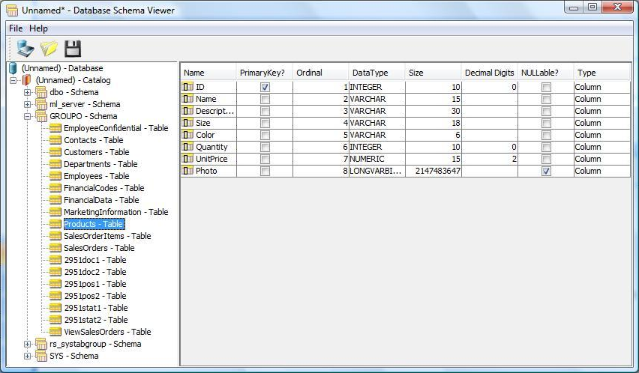
Schema Design
Schema on Write
Indecision is the basis of flexibility
Notes:
Traditional build to schema
Schema on write – comments field example - new data source example
Still need Schema
-- Indecision is the basis of flexibility
-- Want to be able to change your mind at little or no engineering cost
New source of data integration (time-to-action/time-to-value)
Still may choose to do some optimization talk about that in a bit

Slide 57
Schema Design
Schema on Write
Schema on Read
Before use
Multiple schemas
“Free to change”
Fast source of data integration
VS
Indecision is the basis of flexibility
Notes:
Traditional build to schema
Schema on write – comments field example - new data source example
Still need Schema
-- Indecision is the basis of flexibility
-- Want to be able to change your mind at little or no engineering cost
New source of data integration (time-to-action/time-to-value)
Still may choose to do some optimization talk about that in a bit

Slide 58
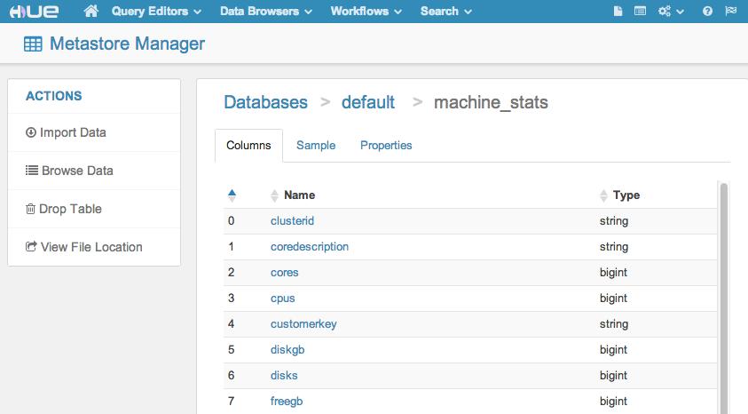
Schema Design
Schema on Write
Schema on Read
VS
Indecision is the basis of flexibility
Notes:
Traditional build to schema
Schema on write – comments field example - new data source example
Still need Schema
-- Indecision is the basis of flexibility
-- Want to be able to change your mind at little or no engineering cost
New source of data integration (time-to-action/time-to-value)
Still may choose to do some optimization talk about that in a bit
----- Meeting Notes (9/18/14 10:10) -----
hide these

